Slide 1

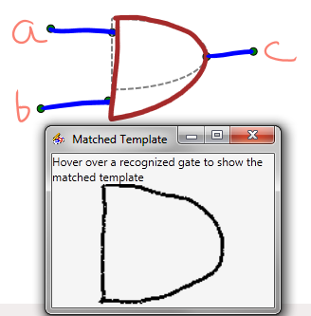
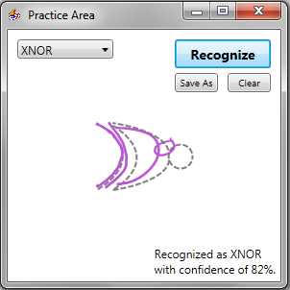
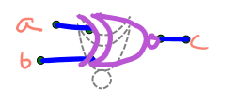
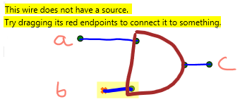



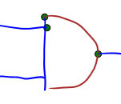

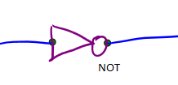
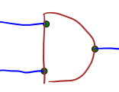
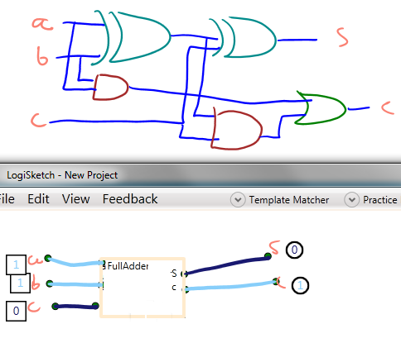
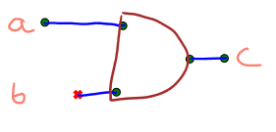
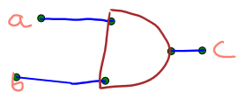

LogiSketch – An Intuitive System for Sketching and Simulating Logic Circuits
Fiona Foo, Andy Kearney, Alexa Keizur, Calvin Loncaric, Miranda Parker, Jessi Peck, Kiley Sobel
Introduction
Our program seeks to provide users with an intuitive system for sketching, editing, recognizing, and simulating logic circuits in a tablet environment.
Our users for this program are college students in an introductory computer science or digital design class.
User Interface
User Study
Background
There is a complex relationship between users’ drawing styles and how hard the recognizers have to work to correctly recognize the components of users’ sketches. If users adapt their drawing style to what makes the recognizers work the best, then recognition does not have to be as rigorous.
Research Question
Will users adapt their drawing styles to improve recognition when given certain feedback from the system?
Procedure
Condition 1: With ghost gates, and Condition 2: Without ghost gates (see Ghost Gates under User Interface)
Hypothesis: Users in both cases will adapt their drawing styles but users in Condition 1 will make more significant changes that will increase correct recognition rates compared to the users in Condition 2.
12 participants, 14 sketches each
Measure: How the users’ drawing styles changed over time (by sketch trial) by calculating the correct recognition rate (the percent of the total gates that were recognized correctly by the system) for each sketch.
Analysis & Results
Performing t-tests and linear regression on the data provided no significant results overall. Thus, we concluded that users will not change their drawing styles.
Improve recognition accuracy
Practice drawing with templates to match the recognizer’s expectations more closely.
Train the adaptive recognizer on user drawings.
Expose recognition algorithm
Show the user the actual template matched to their drawing.
Recognition: Five Stages
Stroke Classification
Stroke Grouping
Shape Recognition
Shape Connection
Shape Refinement
Shape Recognition
Previously, recognition was based on four different algorithms whose results where combined to determine what gate a user’s drawing was recognized as. However, it was not very accurate because of errors in the code for the algorithms. Also, this method of recognition was overly complicated for the programmer, and hard for the user to understand.
To improve recognition accuracy, we created an adaptive image-based recognizer to classify logic gates. When a user corrects an error, we add the image of the shape to the recognizer, thereby making it adapt to a user’s drawing style.
Display and correct recognition errors
Visually indicate gate recognition results and display an ideal template.
Specify the direction that the gate is facing.
Display circuit errors
Highlight and describe connection errors and their solutions so users can correct them easily.
Shape Refinement
Creating complex circuits
Use previously constructed circuits as building blocks.
The sketch refiner uses information from various stages of recognition to refine the recognized parts of the sketch and try to find a more correct interpretation.
Correct parsing errors
Drag disconnected endpoints to gates or text to extend the wire and connect the circuit elements.
Future Work
Further improve on refining. Current refinement improves some, but has potential for much more.
Investigate the user study under different conditions. Additional studies using the Adaptive recognizer.
Use in an introductory computer science class.
Find broken connections Fix context problems Fix grouping problems
By making small changes one at a time, the refiner tries to optimize the recognition. It searches for interpretations where every shape is correctly connected and the shape recognizer is the most confident about shape recognition.
Unfortunately, due to various other limitations of our system (and the techniques involved) the refiner is not good enough to work properly. This approach still shows a lot of promise, however.
Acknowledgements:
We’d like to thank our research advisor, Prof. Christine Alvarado, all the students who have worked on this project in the past, and the students who participated in the user studies.
This work is supported in part by an NSF CAREER award (IIS-0546809).

